Slide 1

Rockbuster Stealth LLC Launch Strategy Analysis
Presented by Xuan Nguyen

Slide 2
Overview
Rockbuster Stealth LLC is a movie rental company that used to have stores around the world. Facing stiff competition from streaming services such as Netflix and Amazon Prime, the Rockbuster Stealth management team is planning to use its existing movie licenses to launch an online video rental service in order to stay competitive.

Slide 3
Rockbuster Stealth LLC
1,000 films
599 customers
108 countries
2 stores
2 employees

Slide 4
Key Questions
Which movies contributed the most/least to revenue gain?
What was the average rental duration for all videos?
Which countries are Rockbuster customers based in?
Where are customers with a high lifetime valued based?
Do sales figures vary between geographic regions?

Slide 5
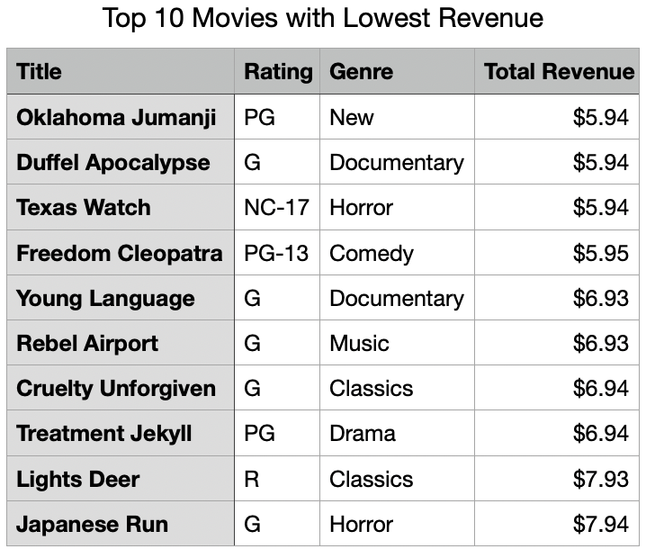
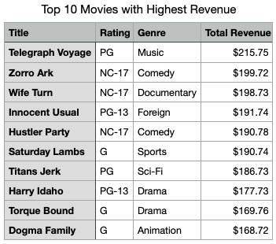
Revenue Gain by Titles
There is a large difference between the highest and lowest revenue gain.

Slide 6
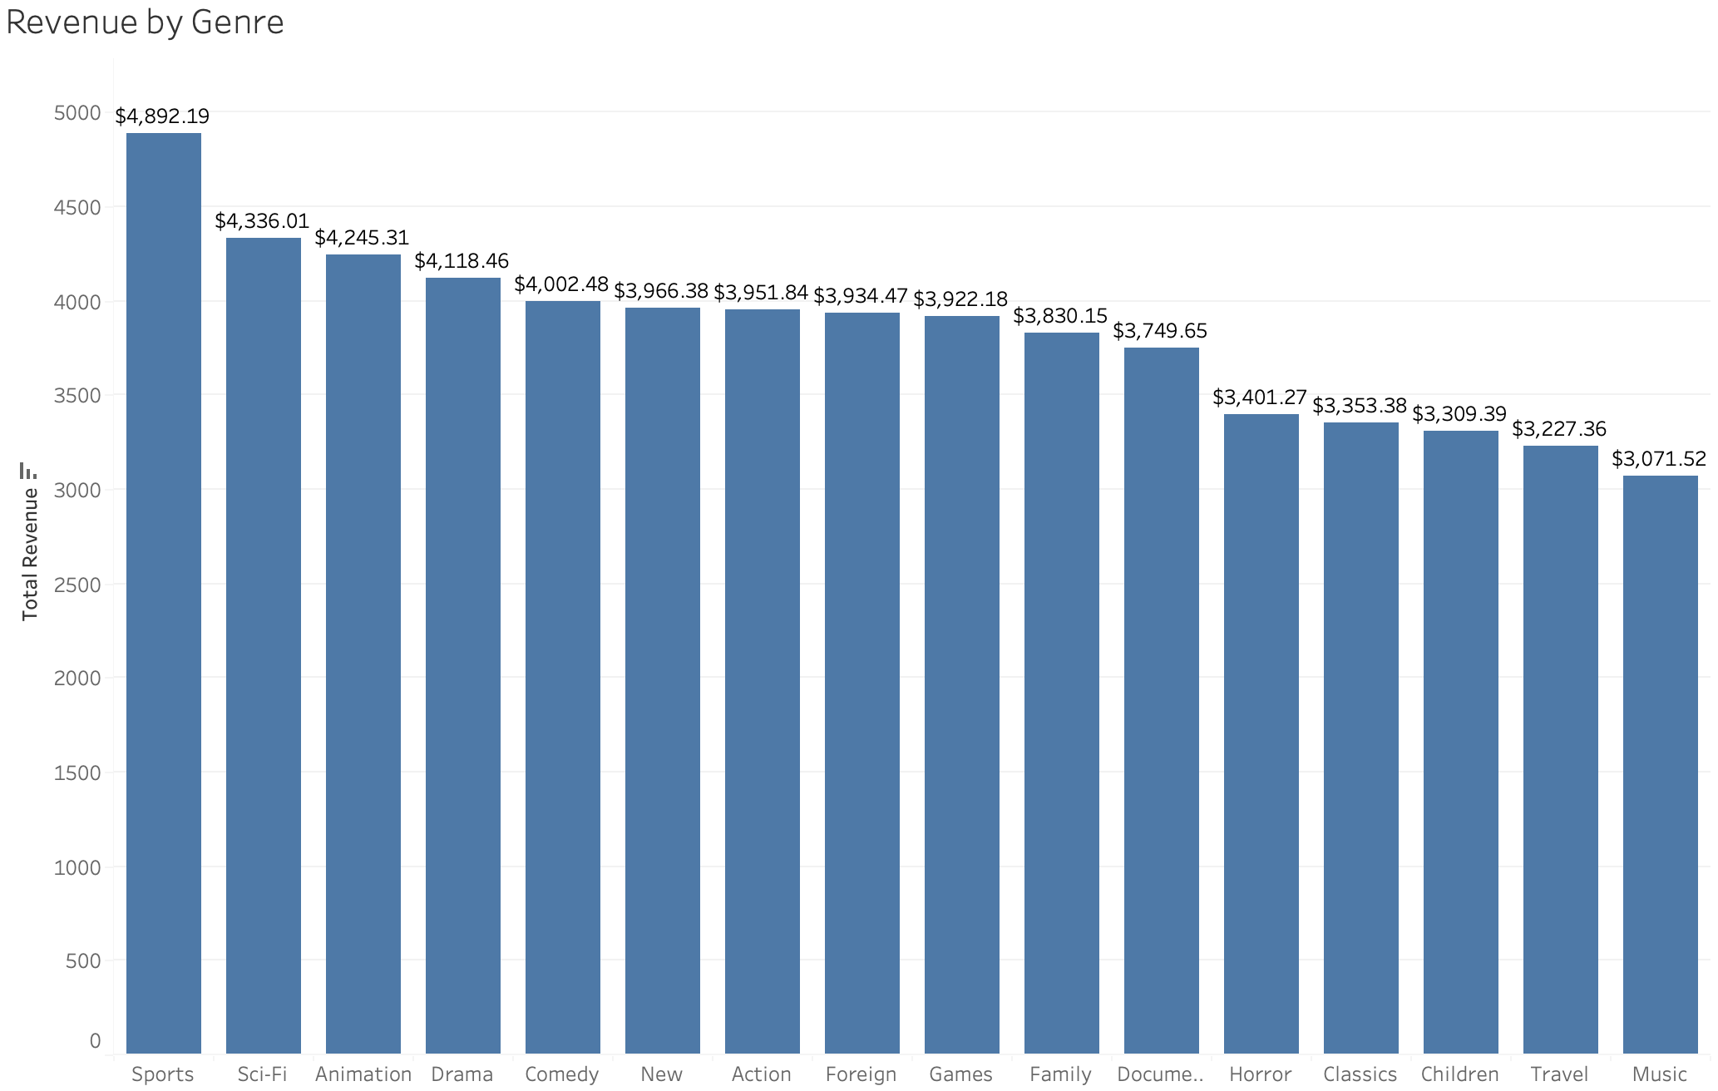
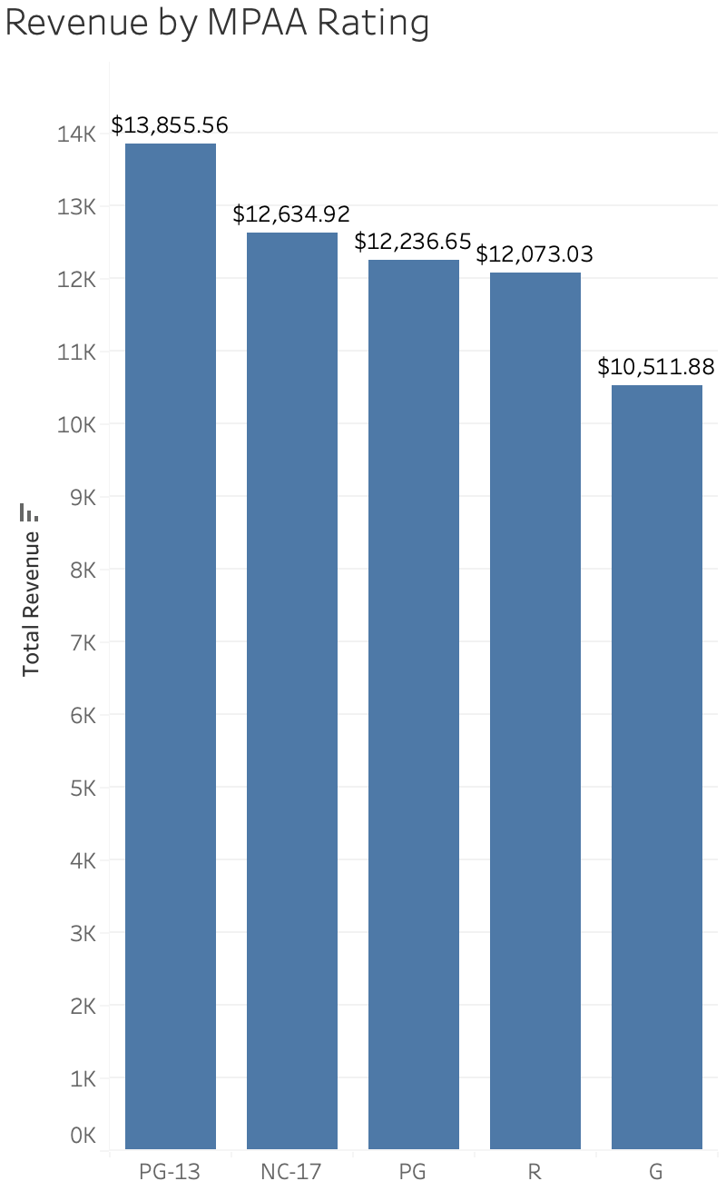
Revenue Gain by Genre & Rating
The sports genre is the top genre, leading by $556.18
PG-13 rating is the top rating, leading by $1,220.64

Slide 7
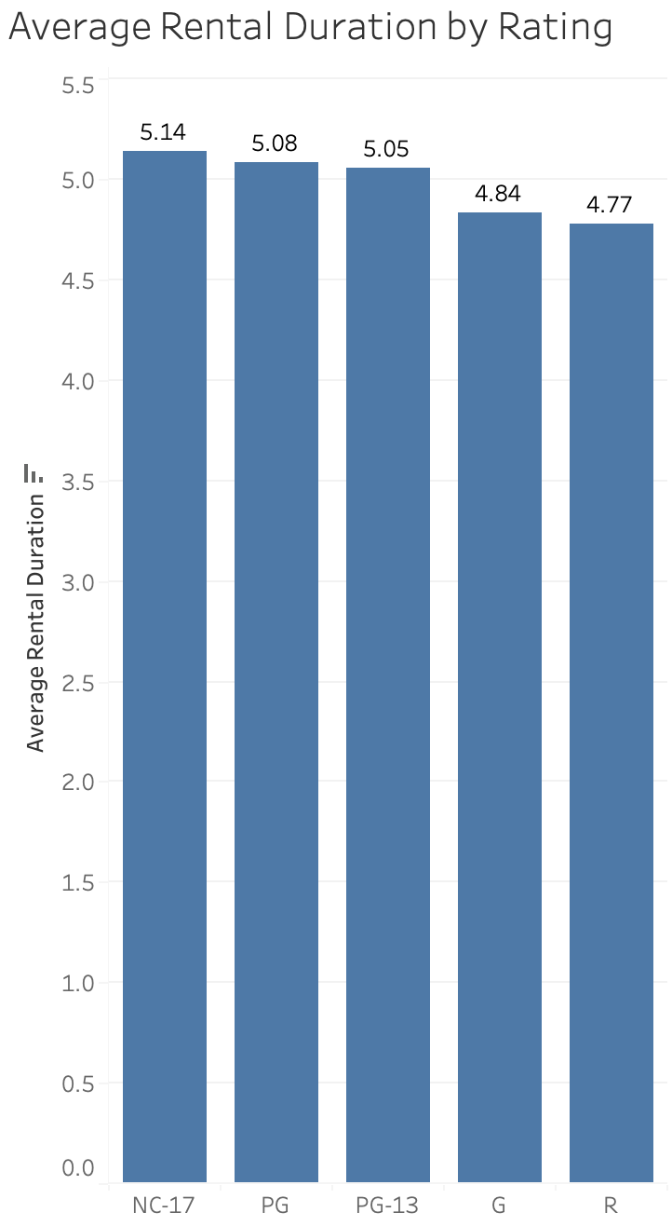
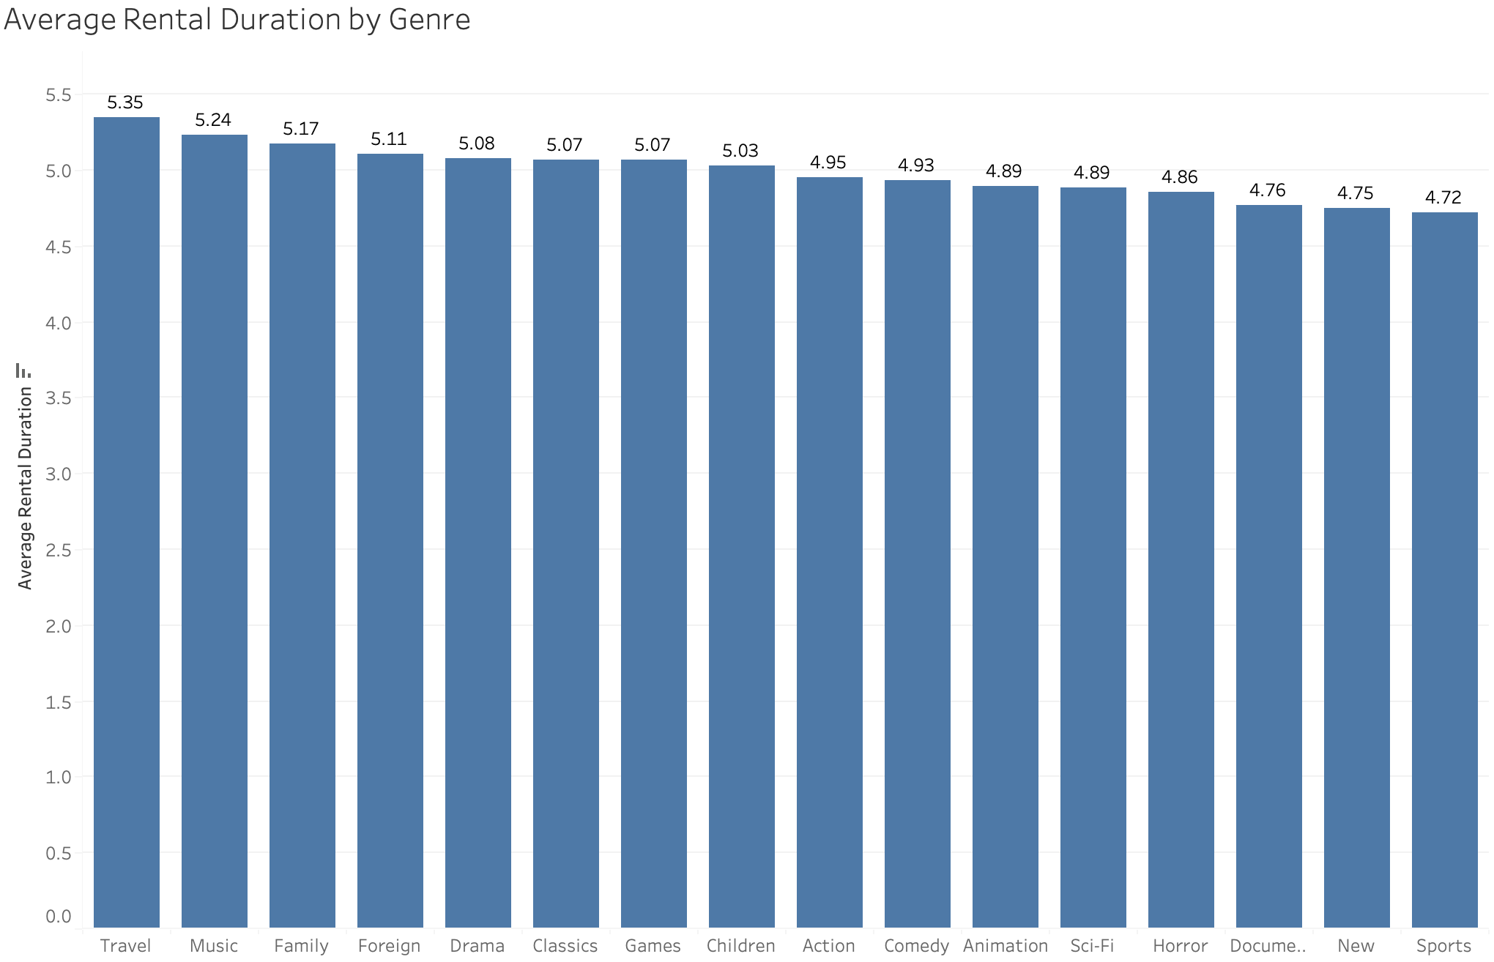
Average Rental Duration
The average rental duration is between 4-5 days
NC-17 is the top rating
Travel is the top genre

Slide 8
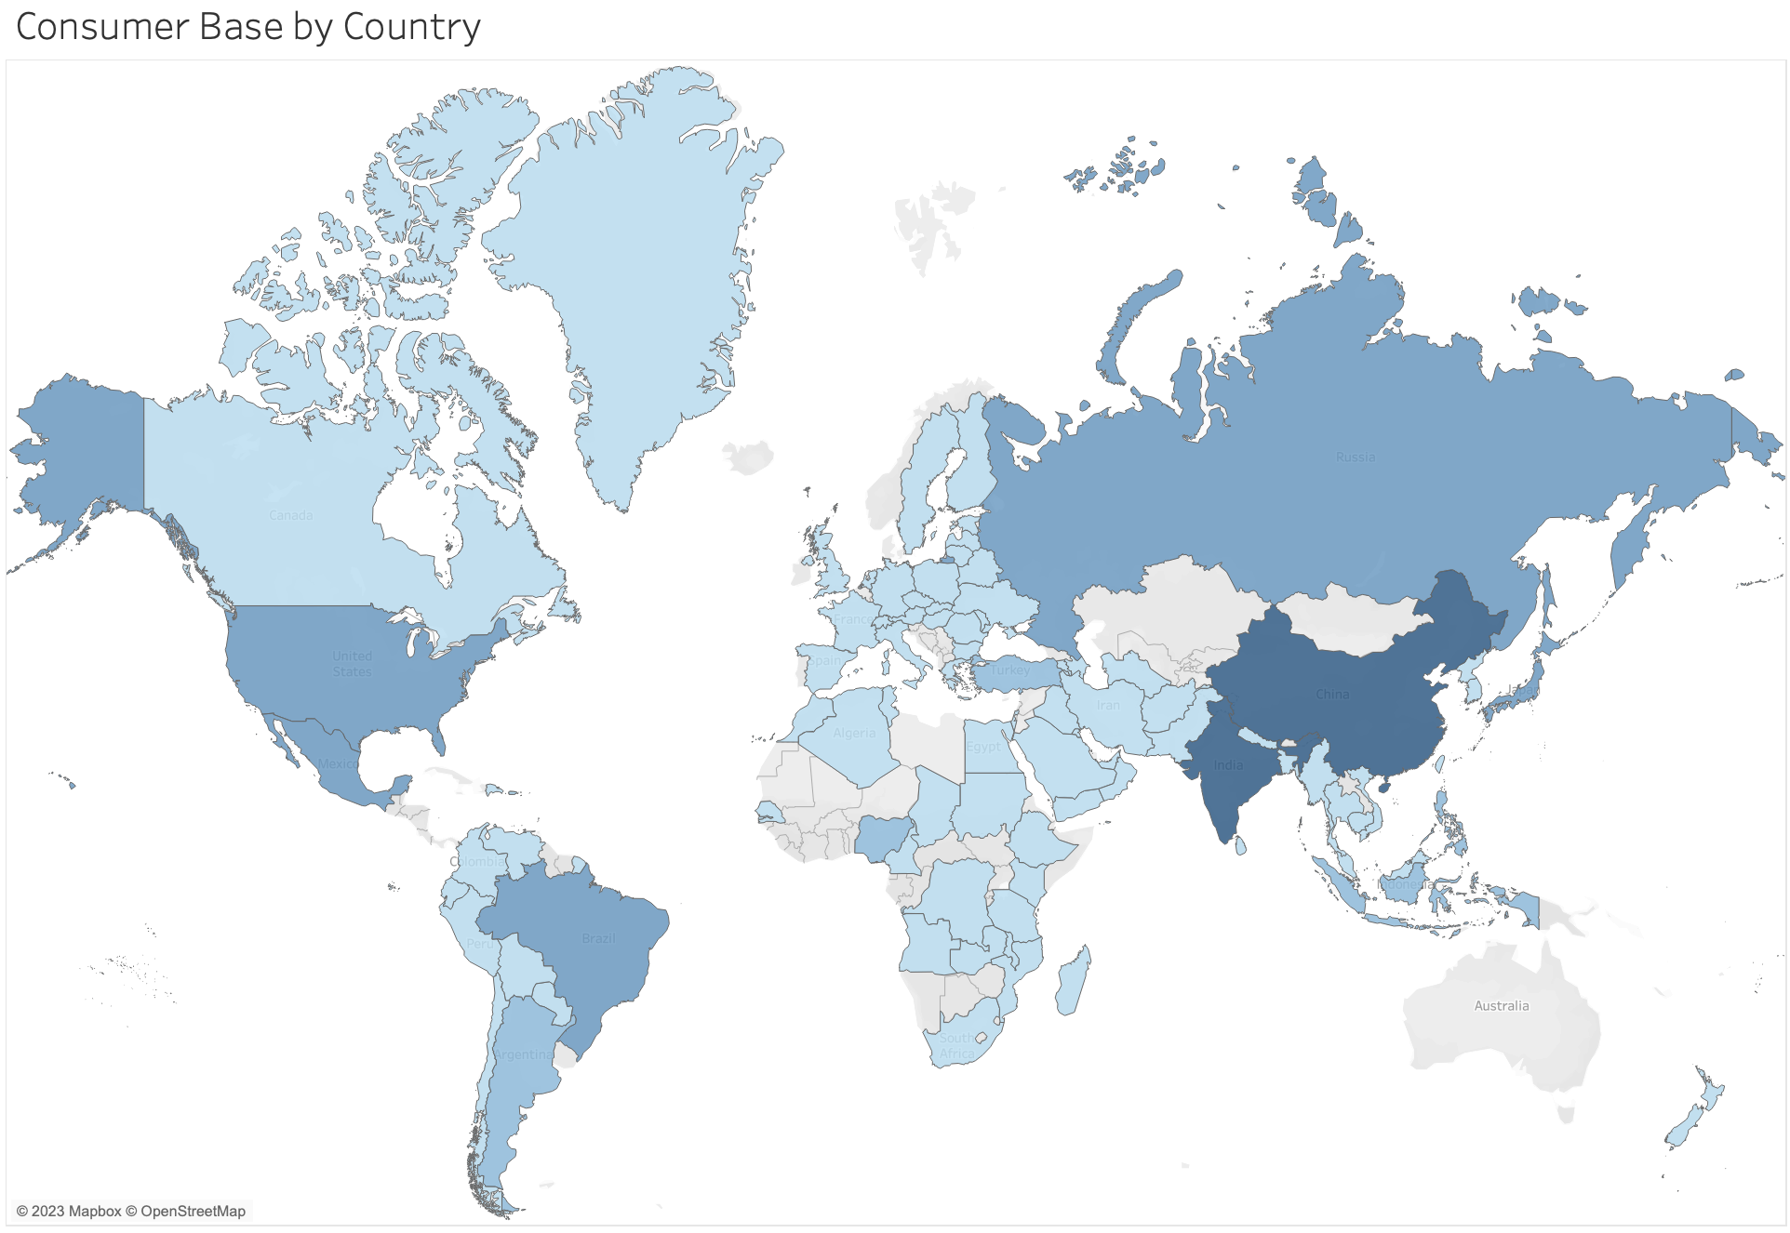
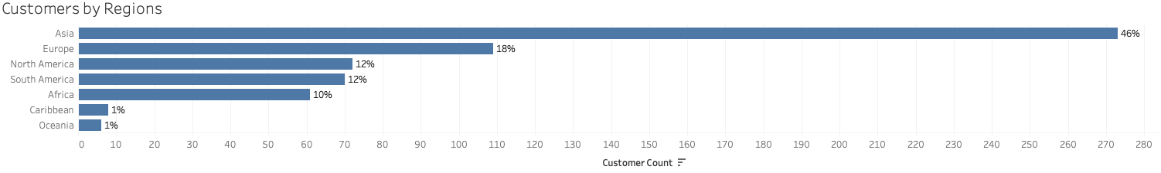
Customer Base
The darker shaded regions represents higher number of total customers
46% of the customer base is in the Asian region

Slide 9
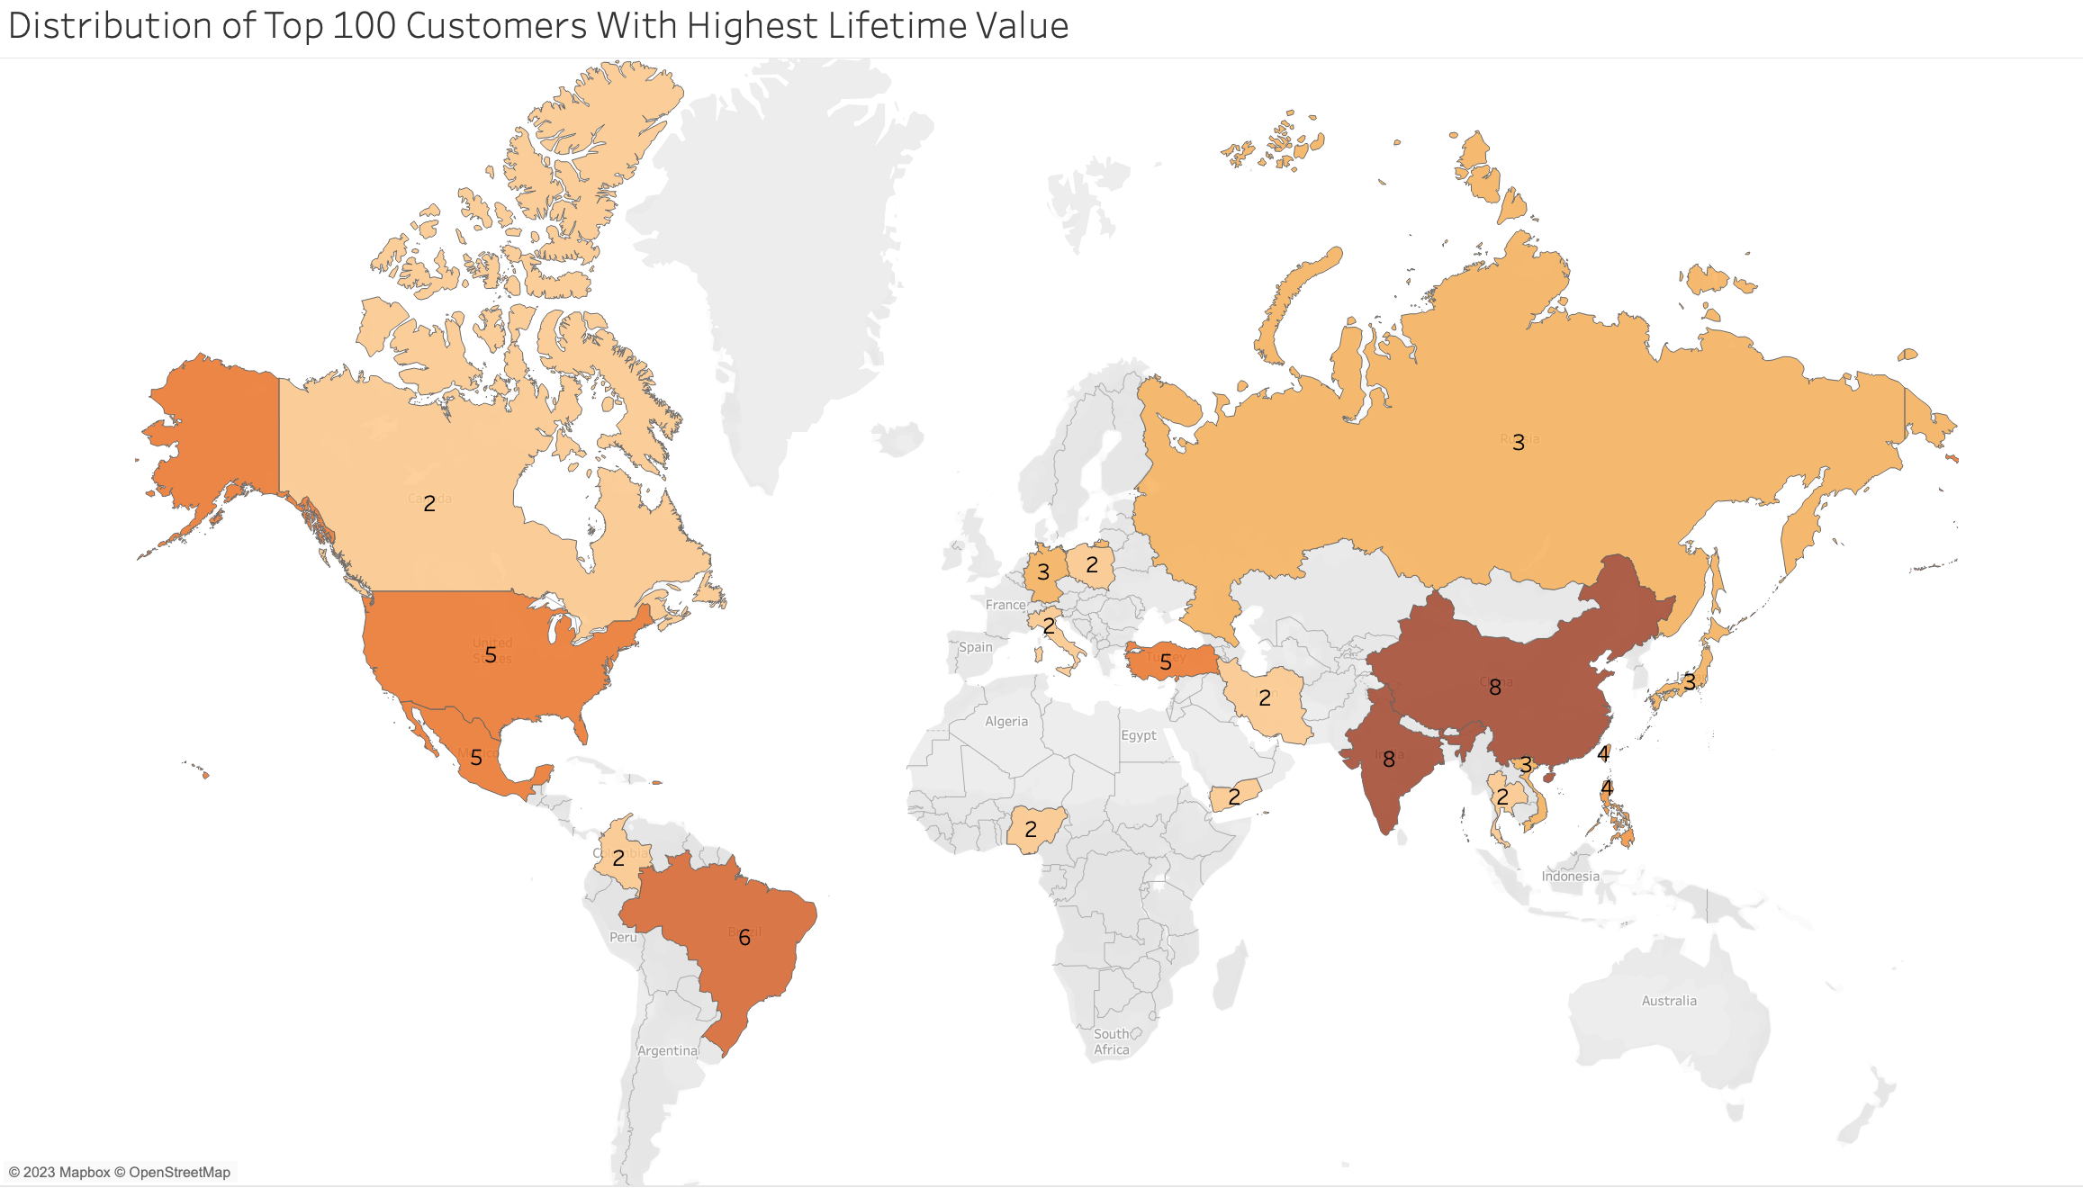
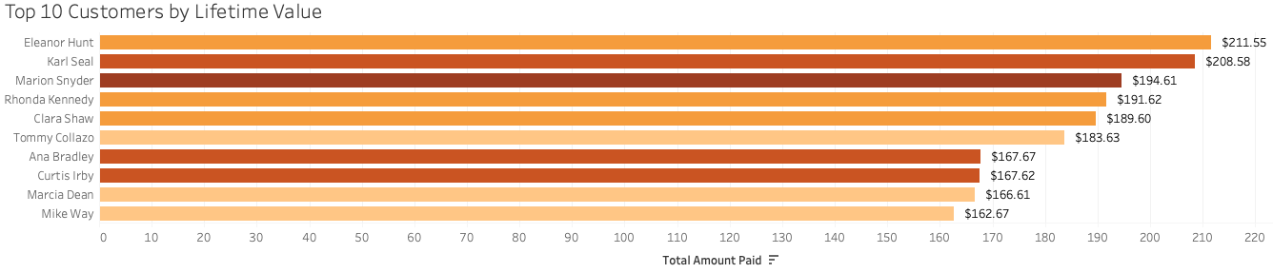
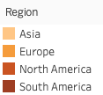
Top Customers
The map indicates the distribution of the top 100 customers with the highest lifetime value

Slide 10
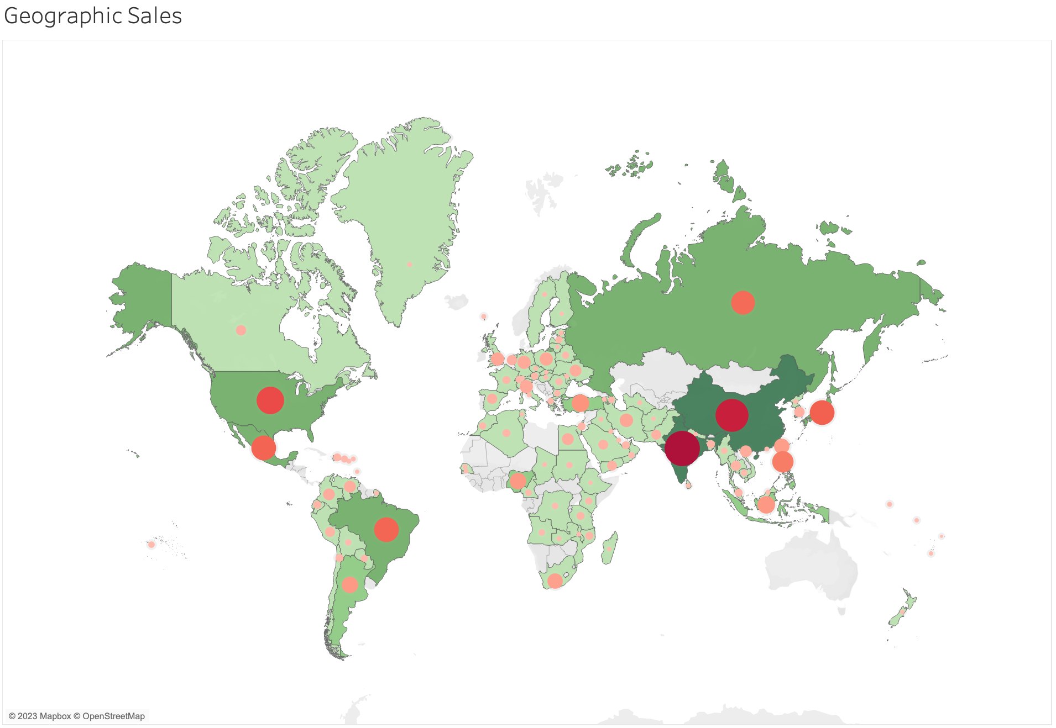
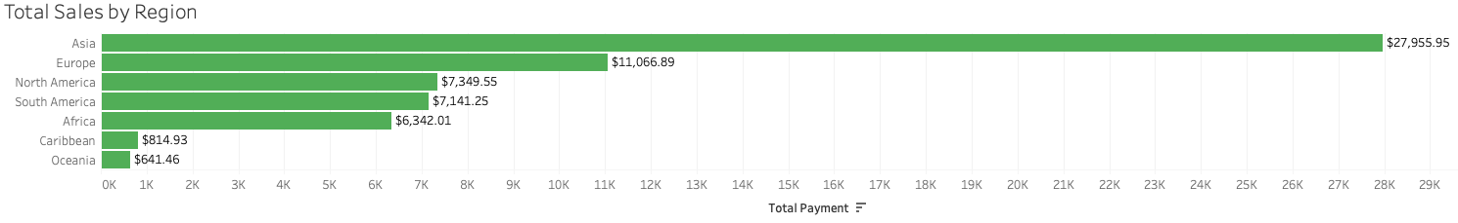
Sales
The shaded region represents customer count while the shape represents total sales
Asia significantly leads the regions in total sales

Slide 11
Conclusion
The highest revenue movie genre is Sports and the lowest revenue is Music. Additionally, the highest revenue movie rating is PG-13 and the lowest revenue is G.
The average rental duration for movie genres and ratings are between 4-5 days.
46% of the customer base is from the Asian region with India and China leading in sales.
The top 10 customers with the highest lifetime values are in the Asia, Europe, North America and South America.
Asia significantly leads the regions in sales with $27,955.95.

Slide 12
Recommendations
Create a loyalty program to reward customers
Expand the film database to allow more options for customers
Create marketing plans for all regions to attract more customers

Slide 13
Questions/Comments
For further information or questions contact Xuan at xuan@rockbuster.com
Tableau Visualizations:
Consumer Base
Distribution of Top 100 Customers with Highest Lifetime Value
Geographic Sales

